Slide 1
Chapter 4
Boolean Algebra and Logic Simplification

Slide 2
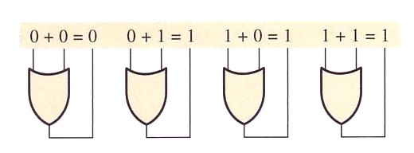
Boolean Operations and Expressions
Boolean Addition (OR)

Slide 3
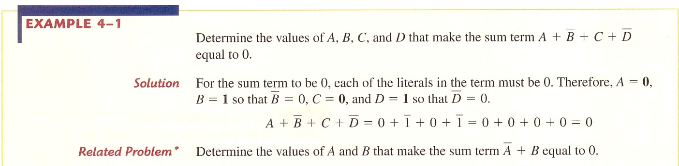

Slide 4
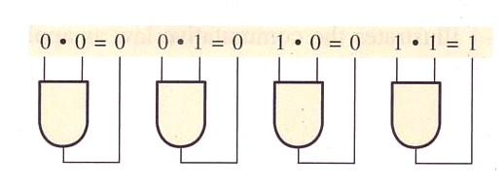
Boolean Multiplication (AND)

Slide 5
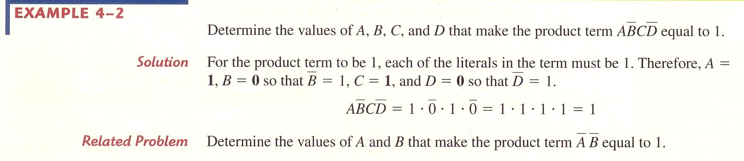

Slide 6
Laws and Rules of Boolean Algebra
Laws:
  Commutative
  Associative
  Distributive
Rules

Slide 7
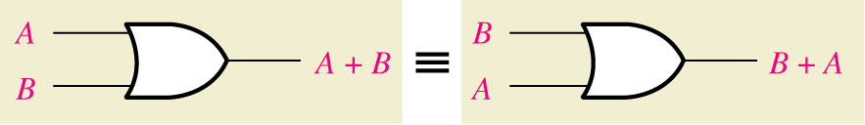
Figure 4--1 Application of commutative law of addition.

Slide 8
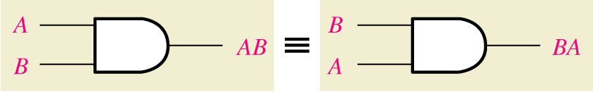
Figure 4--2 Application of commutative law of multiplication.

Slide 9
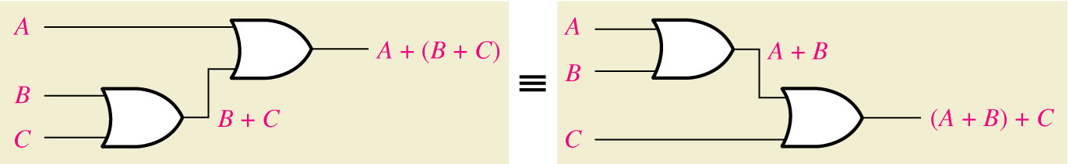
Figure 4--3 Application of associative law of addition

Slide 10
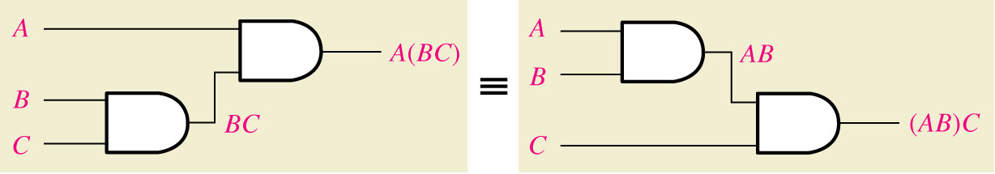
Figure 4--4 Application of associative law of multiplication

Slide 11
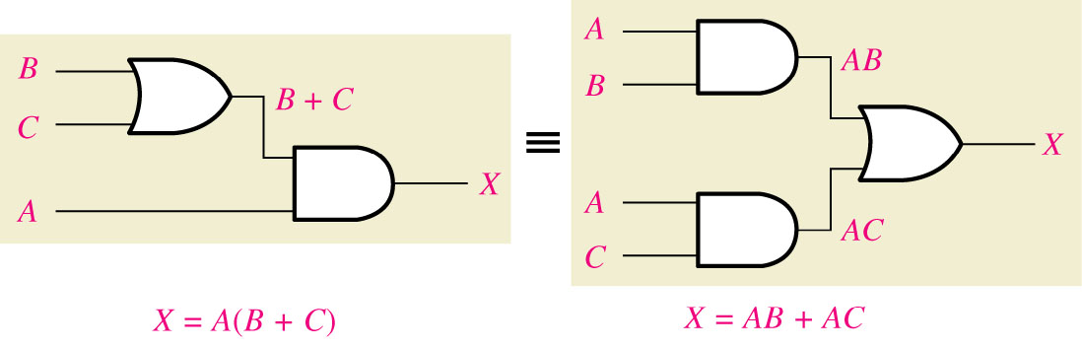
Figure 4--5 Application of distributive law

Slide 12
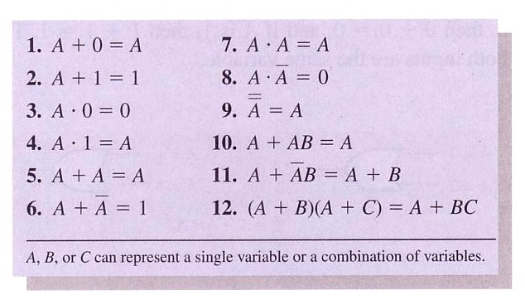

Rules of Boolean Algebra

Slide 13
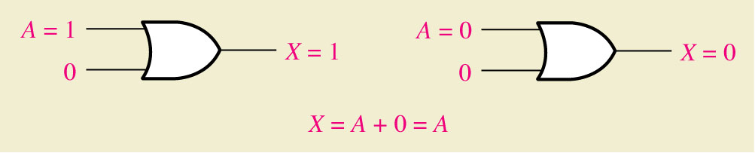
Figure 4--6 RULE 1

Slide 14
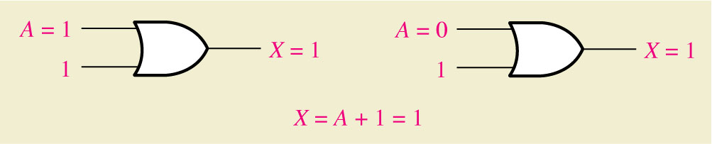
Figure 4--7 RULE 2

Slide 15
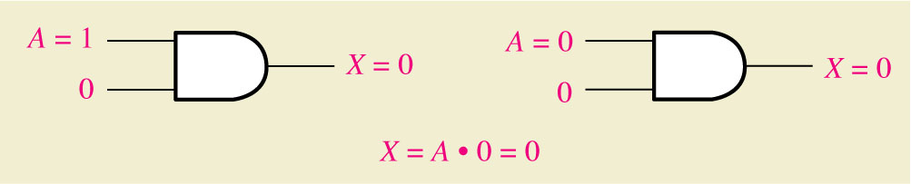
Figure 4--8 RULE 3

Slide 16
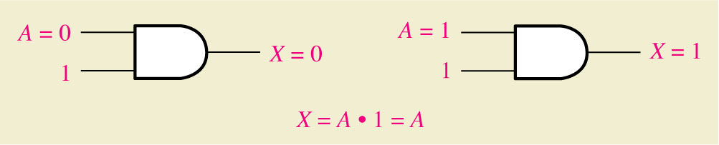
Figure 4--9 RULE 4

Slide 17
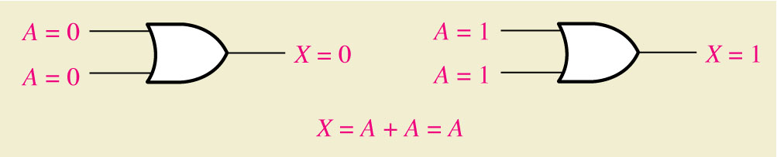
Figure 4--10 RULE 5

Slide 18
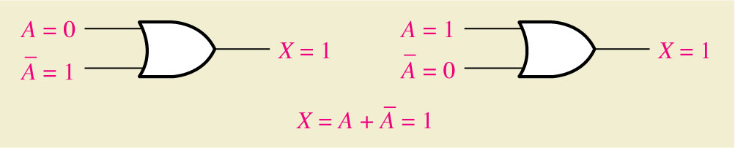
Figure 4--11 RULE 6

Slide 19
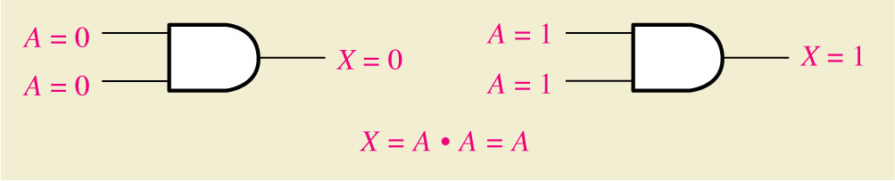
Figure 4--7 RULE 7

Slide 20
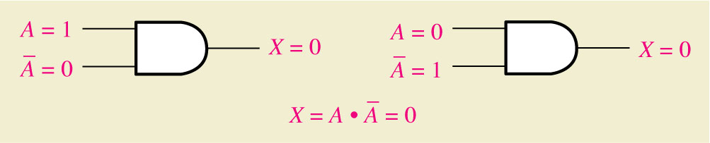
Figure 4--13 RULE 8

Slide 21
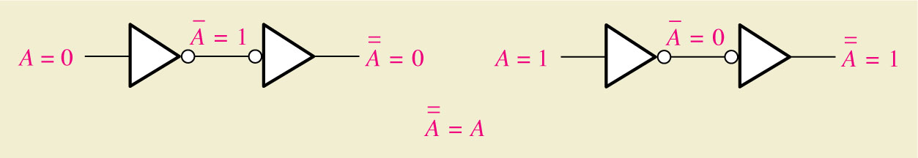
Figure 4--14 RULE 9

Slide 22
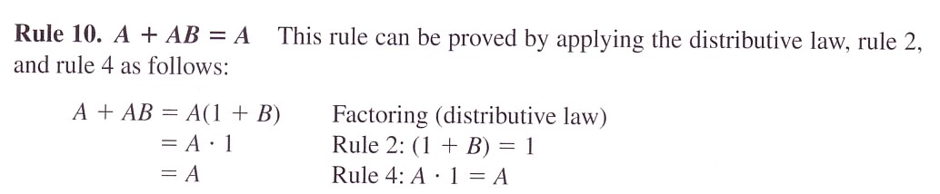
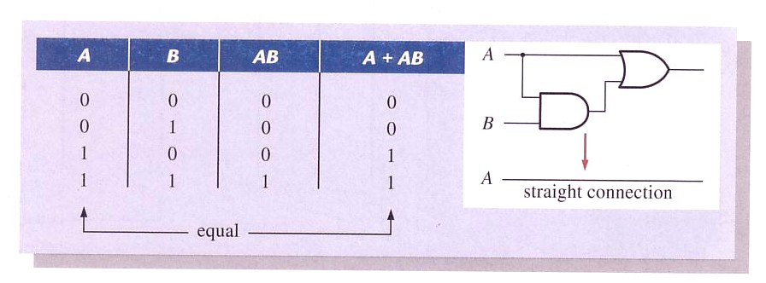


Slide 23
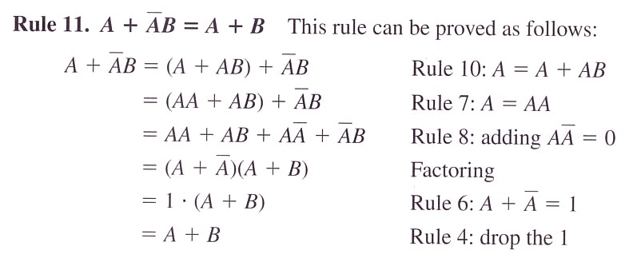
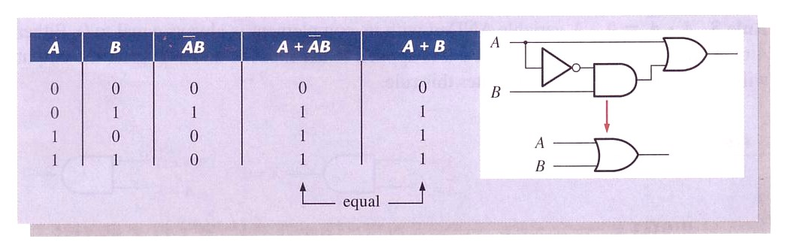


Slide 24
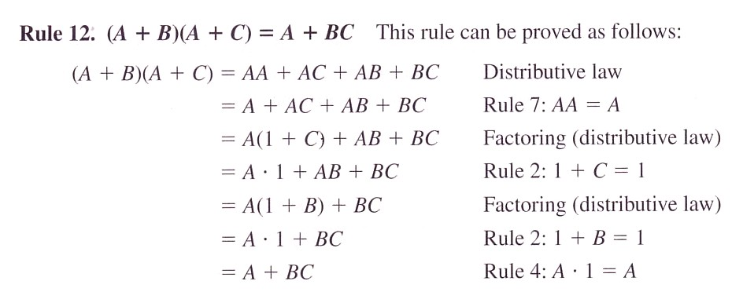
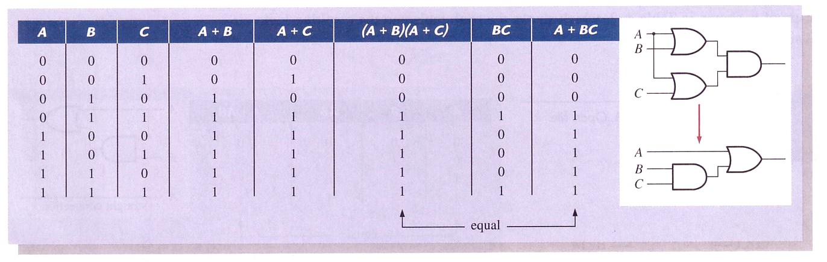


Slide 25
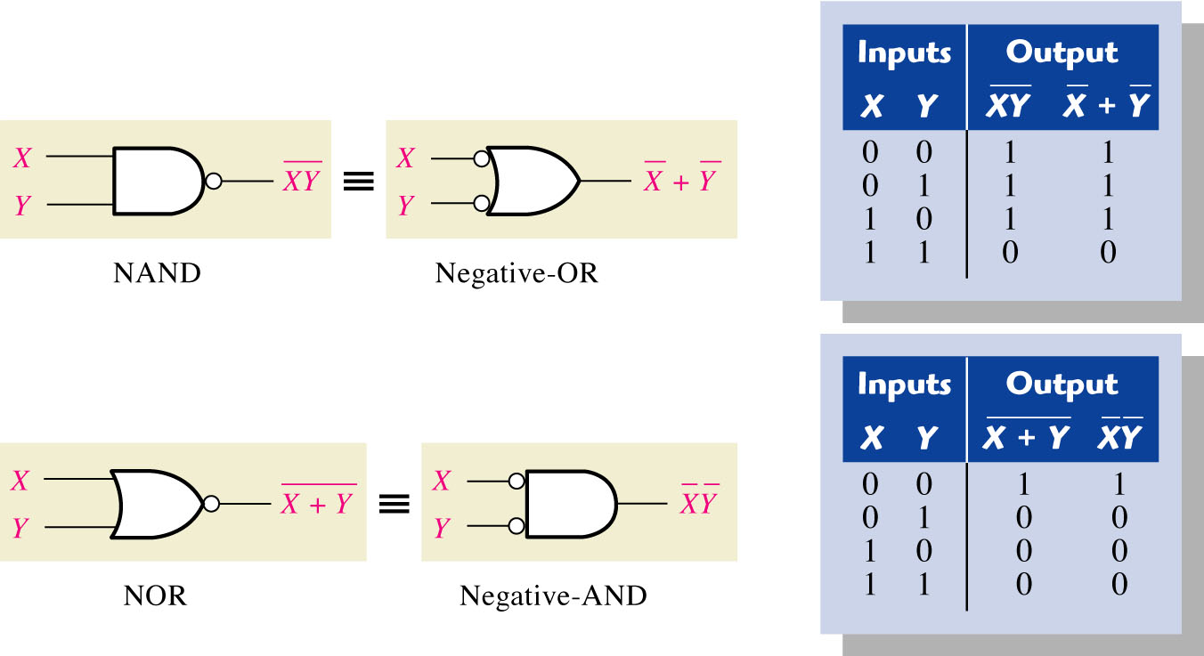
DeMorgan’s Theorem
Figure 4--15 Gate equivalencies and the corresponding truth tables that illustrate DeMorgan’s theorems. Notice the equality of the two output columns in each table. This shows that the equivalent gates perform the same logic function.

Slide 26
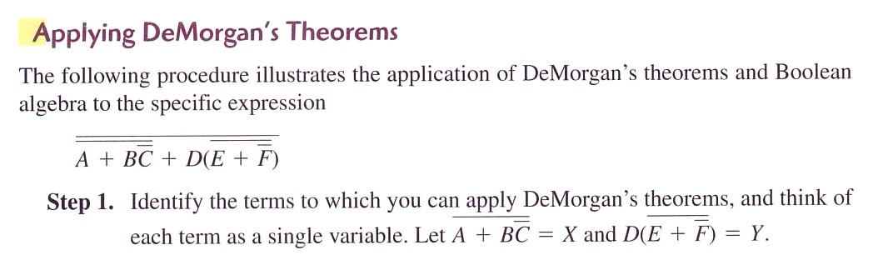

Slide 27
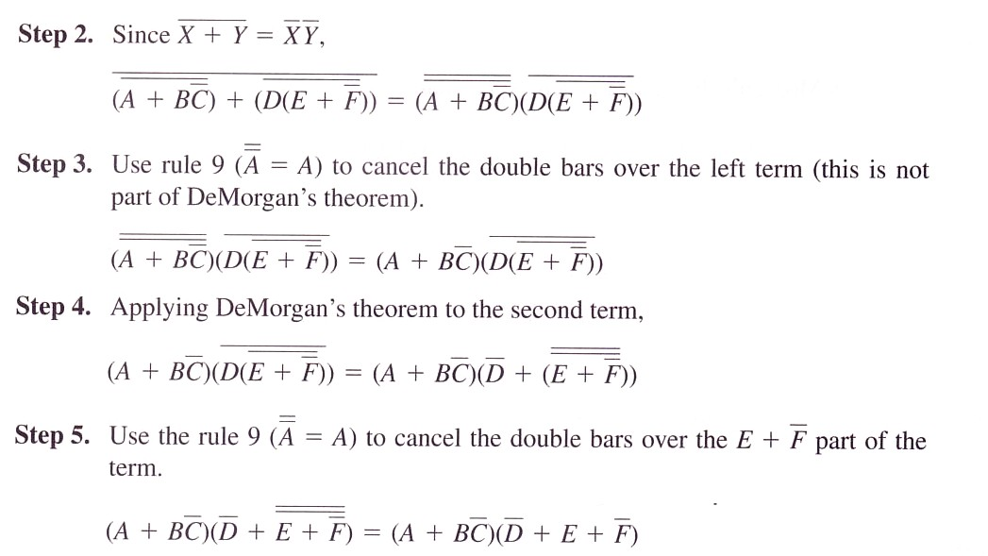

Slide 28
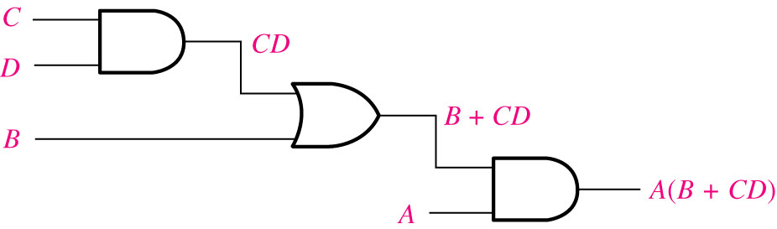
Boolean Expression for a Logic Circuit
Figure 4--16 A logic circuit showing the development of the Boolean expression for the output.

Slide 29
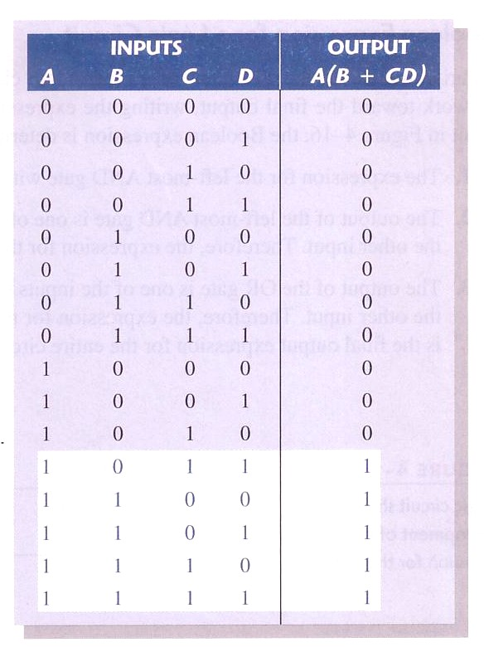
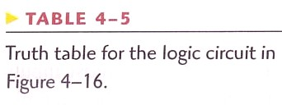
Constructing a Truth Table for a Logic Circuit
Evaluating the expression and putting results in truth table format

Slide 30
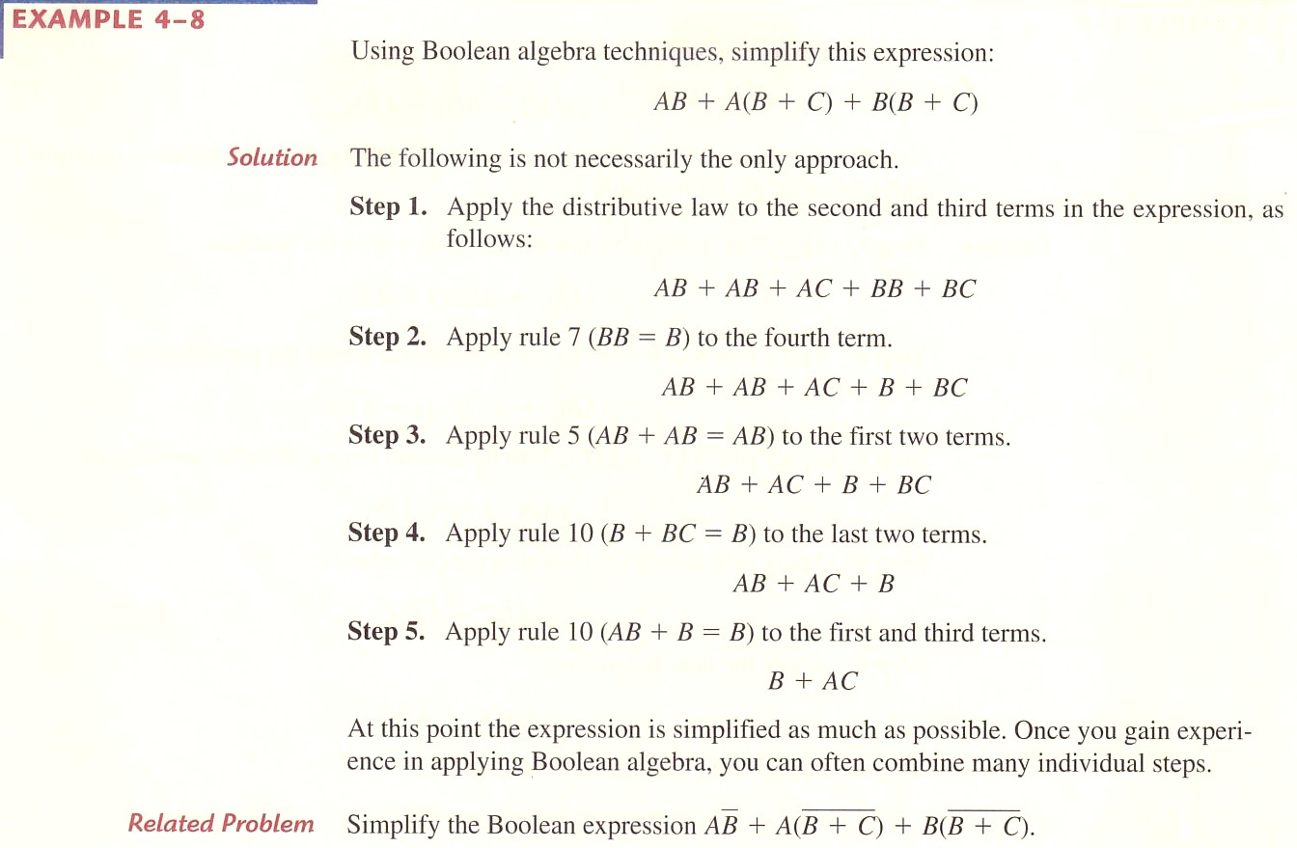
Simplification Using Boolean Algebra

Slide 31
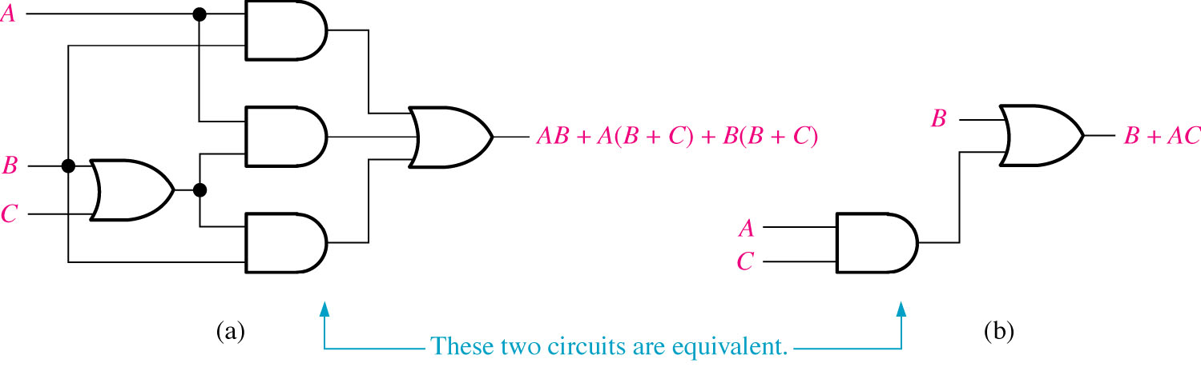
Figure 4--17 Gate circuits for Example 4-8

Slide 32
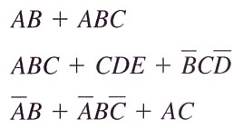
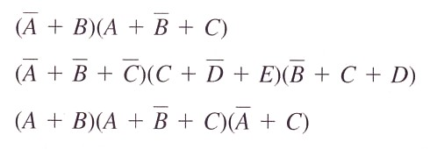
Standard Forms of Boolean Expressions
Sum-of-Products (SOP) Form
Product-of-Sum (POS) Form

Slide 33
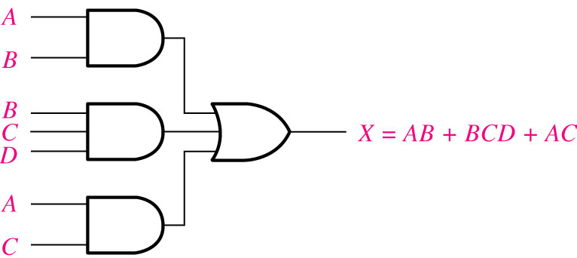
SOP Form
Figure 4--18 Implementation of the SOP expression AB + BCD + AC.

Slide 34
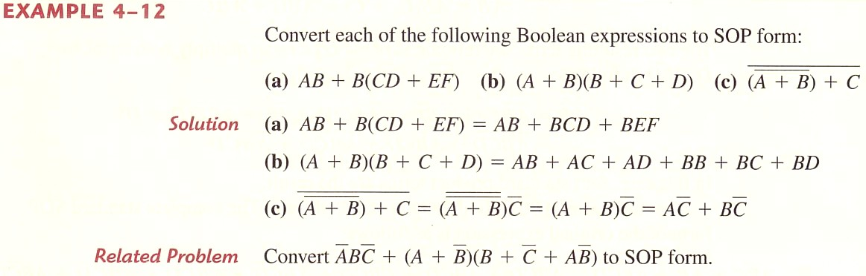

Slide 35
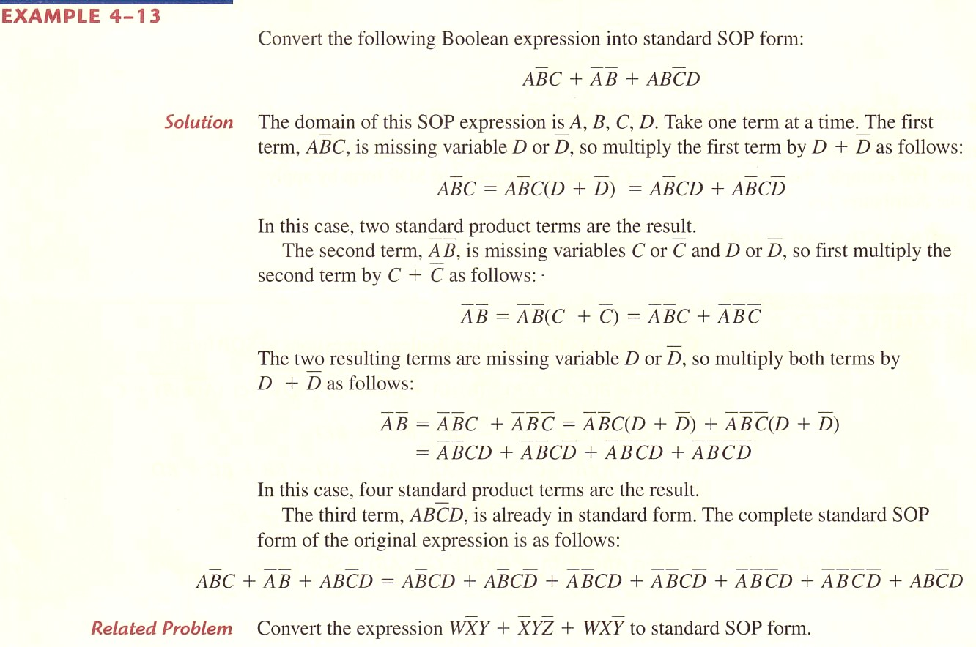
Standard SOP Form

Slide 36
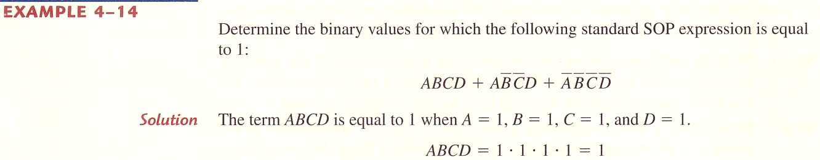
Binary Representation of Product Term

Slide 37
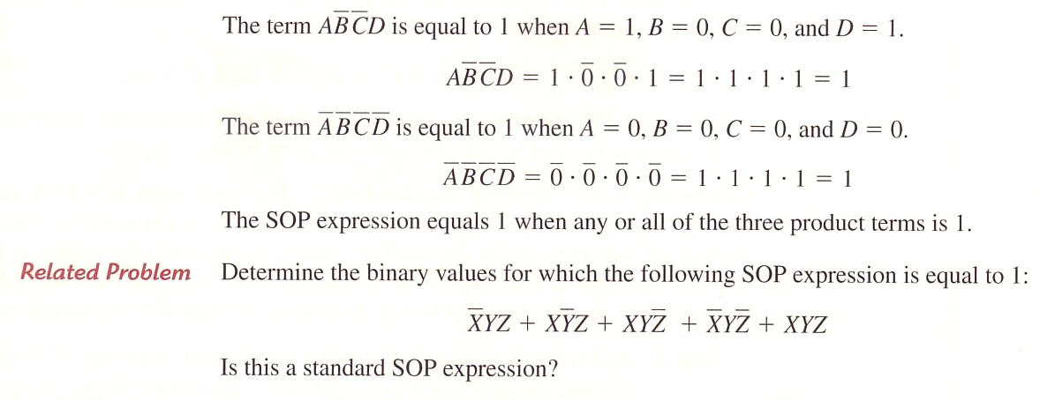

Slide 38
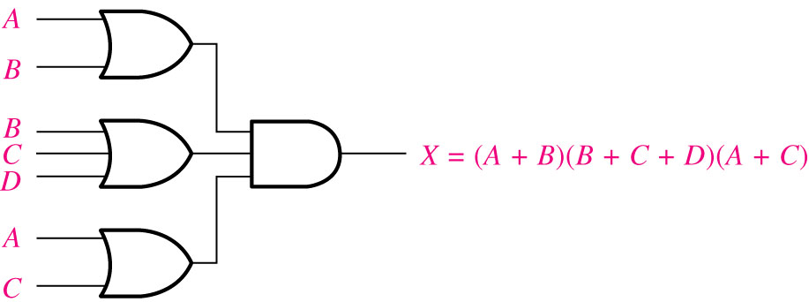
Figure 4--19 Implementation of the POS expression (A + B)(B + C + D) (A + C).
POS Form

Slide 39
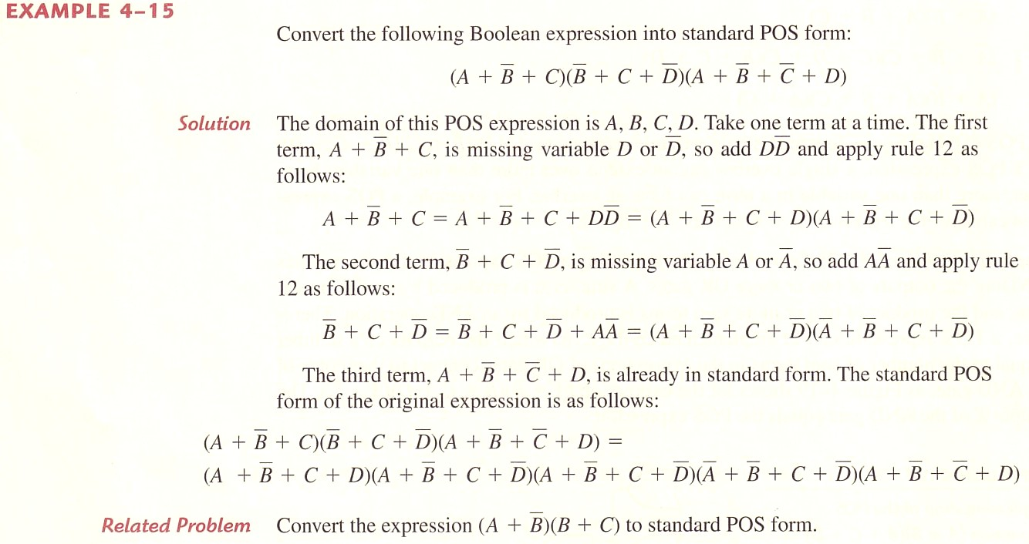
Standard POS Form

Slide 40
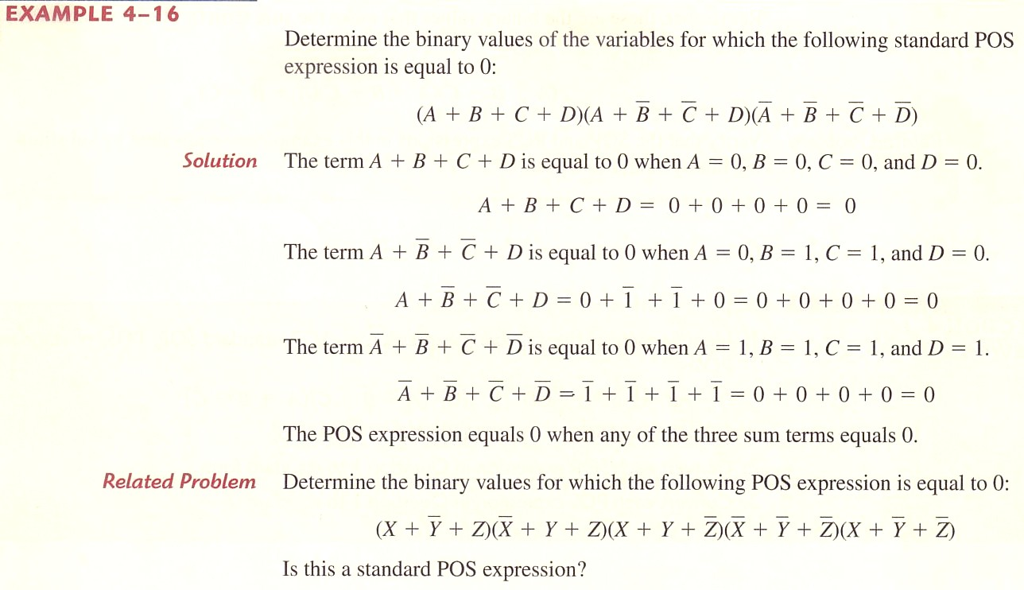
Binary Representation of Sum Term

Slide 41
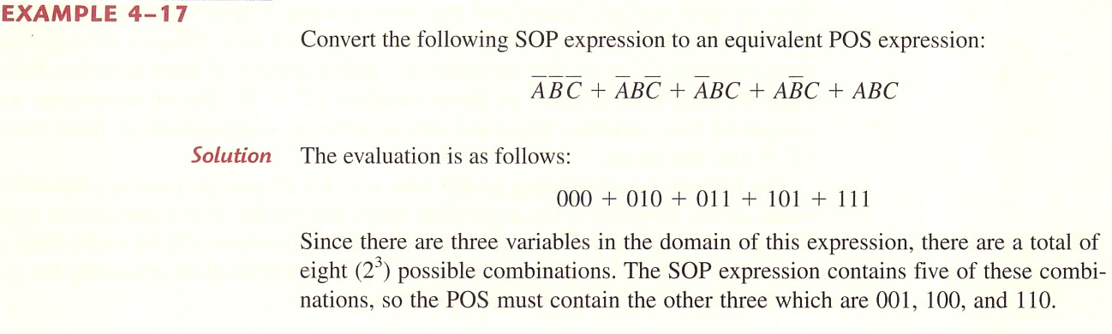
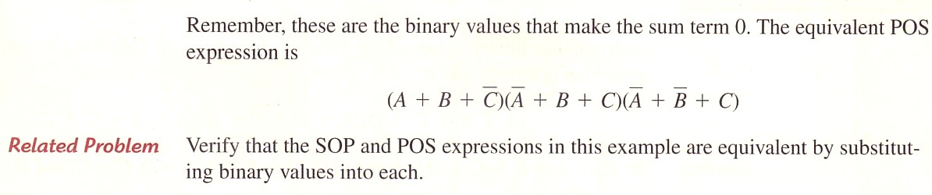
Converting Standard SOP to Standard POS

Slide 42
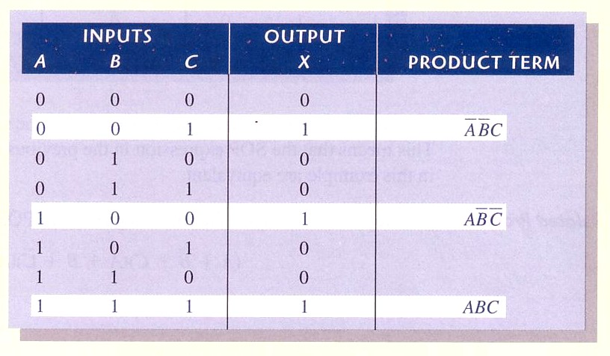
Converting SOP to Truth Table

Slide 43
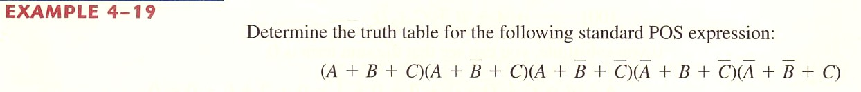
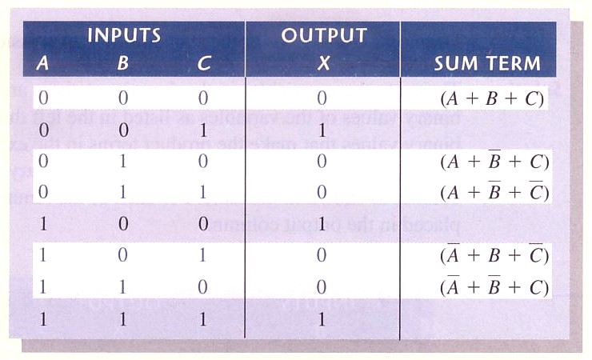
Converting POS to Truth Table

Slide 44
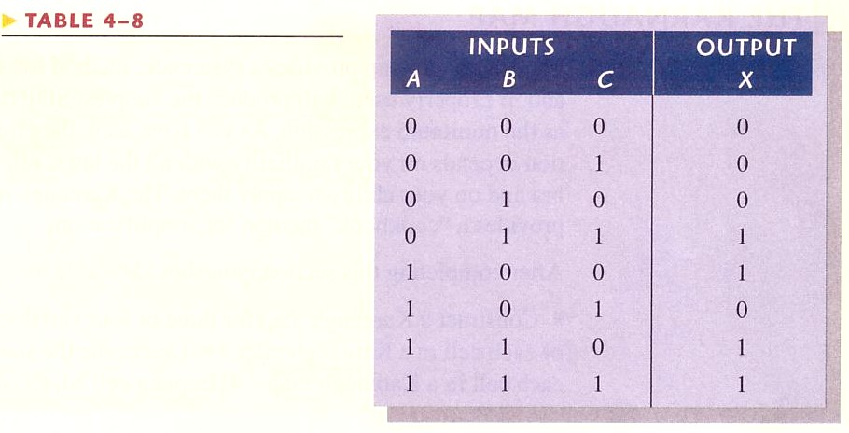
Determining Standard Expressions from Truth Table

Slide 45
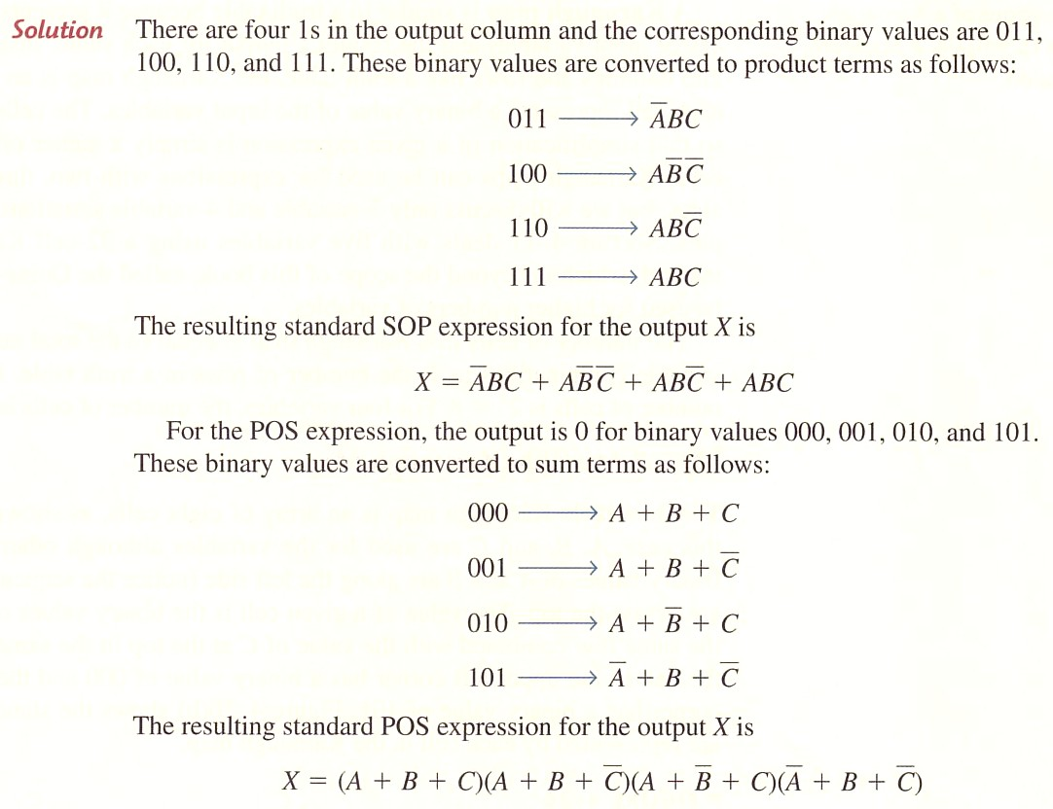

Slide 46


Slide 47


Slide 48


Slide 49


Slide 50

Figure 4--20 A 3-variable Karnaugh map showing product terms.
Karnaugh Map

Slide 51

Figure 4--21 A 4-variable Karnaugh map.

Slide 52

Figure 4--22 Adjacent cells on a Karnaugh map are those that differ by only one variable. Arrows point between adjacent cells.

Slide 53

Figure 4--23 Example of mapping a standard SOP expression.
Karnaugh Map SOP Minimization

Slide 54


Figure 4--24

Slide 55


Figure 4--25

Slide 56

Mapping Nonstandard SOP Expression

Slide 57

Figure 4--26

Slide 58


Slide 59

Figure 4--27

Slide 60

Karnough Map Simplification of SOP Expressions
Example 4-25 Group the 1s in each Karnaugh maps

Slide 61

Figure 4--29

Slide 62

Figure 4-30 Determine SOP
Related Problem: add 1 in the lower right cell (1010) and determine the resulting SOP.

Slide 63

Figure 4--31
Related Problem: For the Karnaugh map in Fig. 4-31(d), add 1 in the 0111 cell and determine the resulting SOP.

Slide 64



101+011+001+000+100

Slide 65




Slide 66

Karnaugh Map POS Minimization
Figure 4--36 Example of mapping a standard POS expression.

Slide 67

Example 4-30

Slide 68


Figure 4--38

Slide 69


Slide 70



Slide 71


Figure 4--39

Slide 72

Converting b/w POS and SOP Using Karnaugh Map

